Slide 1
Illustrating the HIV Care Continuum in U.S. Cities
New Orleans, LA
Notes:
Effective treatment requires successful HIV diagnosis as well as linkage and retention in HIV care - this is the HIV care continuum.
To be the most impactful, public health strategies that address gaps in the HIV care continuum will require detailed information on disproportionately impacted populations.
HIVContinuum.org is a compilation of interactive, online maps that allows users to connect with complex information about the HIV care continuum in several highly impacted cities in the U.S.
HIVContinuum.org is powered by AIDSVu and uses public health surveillance data to increase understanding of the HIV treatment cascade by visualizing the impact of HIV on specific demographic groups, neighborhoods and zip codes.

Slide 2
About
Effective treatment requires successful HIV diagnosis as well as linkage and retention in HIV care - this is the HIV care continuum.
To be the most impactful, public health strategies that address gaps in the HIV care continuum will require detailed information on disproportionately impacted populations.
HIVContinuum.org is a compilation of interactive, online maps that allows users to connect with complex information about the HIV care continuum in several highly impacted cities in the U.S.
HIVContinuum.org is powered by AIDSVu and uses public health surveillance data to increase understanding of the HIV treatment cascade by visualizing the impact of HIV on specific demographic groups, neighborhoods and ZIP Codes.
Notes:
Effective treatment requires successful HIV diagnosis as well as linkage and retention in HIV care - this is the HIV care continuum.
To be the most impactful, public health strategies that address gaps in the HIV care continuum will require detailed information on disproportionately impacted populations.
HIVContinuum.org is a compilation of interactive, online maps that allows users to connect with complex information about the HIV care continuum in several highly impacted cities in the U.S.
HIVContinuum.org is powered by AIDSVu and uses public health surveillance data to increase understanding of the HIV treatment cascade by visualizing the impact of HIV on specific demographic groups, neighborhoods and zip codes.

Slide 3
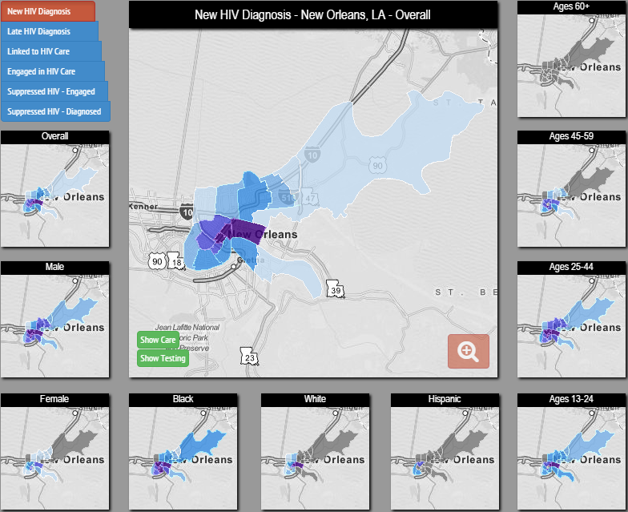
Interactive Maps
Maps at the Neighborhood or ZIP Code Level
New HIV Diagnoses
Late HIV Diagnoses
Linkage to
HIV Care
Engagement in HIV Care
HIV Viral Suppression
Notes:
HIVContinuum uses data from trusted sources to populate its interactive maps.
Neighborhood and ZIP Code data come directly from jurisdictions’ health departments.
The following indicators of the HIV care continuum are mapped overall and by gender, race/ethnicity and age group:
New HIV Diagnoses
Late HIV Diagnoses
Linkage to HIV Care
Engagement in HIV Care
HIV Viral Suppression

Slide 4
Supporting the National HIV/AIDS Strategy
Prevent new HIV infections
Improve care and treatment
Reduce HIV-related health disparities
HIVContinuum provides a new way to identify places where we can improve HIV testing, care and treatment.
Notes:
HIVContinuum can play a direct role in supporting the National HIV/AIDS Strategy goals. The President of the United States recently called for acceleration of our progress on the National Strategy through an initiative focused on the HIV care continuum.
HIVContinuum images can increase a community’s awareness of the problem and lead directly to more action to prevent new HIV infections and improve HIV diagnosis, care and treatment.
HIVContinuum can also be a resource to identify areas and populations most highly affected by HIV, and where HIV prevention, care and treatment resources may be most needed and most impactful.

Slide 5
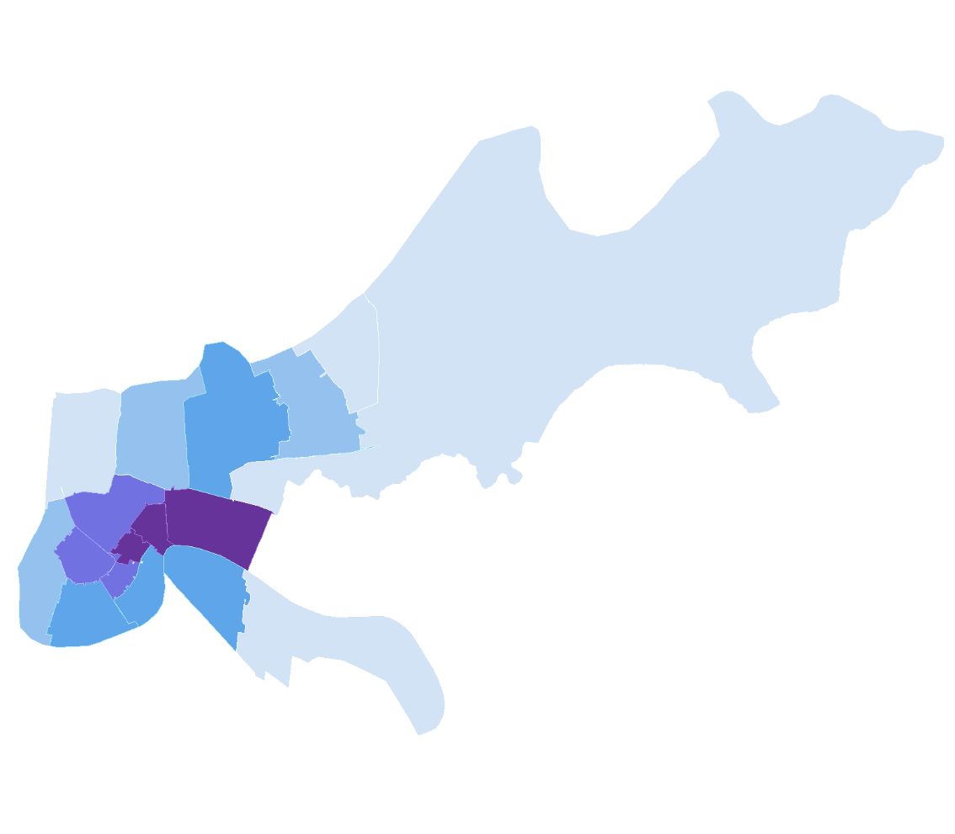
Five-Year Risk of New HIV Diagnosis,
by ZIP Code, New Orleans, 2007-2011
Five-year risk of new HIV diagnosis, 2007-2011 (per 100,000 population of adults/adolescents in 2010)
0-175
176-298
299-443
444-764
765+
Not Shown*
* Gray areas denote where data are not shown to protect privacy because of a small number of cases and/or a small population size.
Notes: Data reflect cases with a date of initial diagnosis 2007-2011 and reported through 10/30/2014. Data reflect cases from ZIP Codes in Orleans and Jefferson Parishes. New HIV diagnoses and late diagnoses indicators come from a mature HIV case surveillance system. Linkage to care, engagement in care, and viral suppression are new indicators and rapidly developing, and thus accuracy and completeness will improve over time. For more information on data limitations and caveats, please see Data Methods.
Data Source: Louisiana Office of Public Health, STD/HIV Program.
Notes:
Five-year risk of new HIV diagnosis, by ZIP Code, New Orleans, 2007-2011 This map shows the reported ZIP-Code-level risk of new HIV diagnosis during a 5-year period (2007-2011) per 100,000 population in 2010. Data reflect cases with a date of initial diagnosis 2007-2011 and reported through 10/30/2014. Data reflect cases from ZIP Codes in Orleans and Jefferson Parishes. Cases missing ZIP Code at diagnosis are excluded from the maps.
New HIV diagnoses and late diagnoses indicators come from a mature HIV case surveillance system. Linkage to care, engagement in care, and viral suppression are new indicators and rapidly developing, and thus accuracy and completeness will improve over time. More information about data methods and sources can be found at HIVContinuum.org.

Slide 6
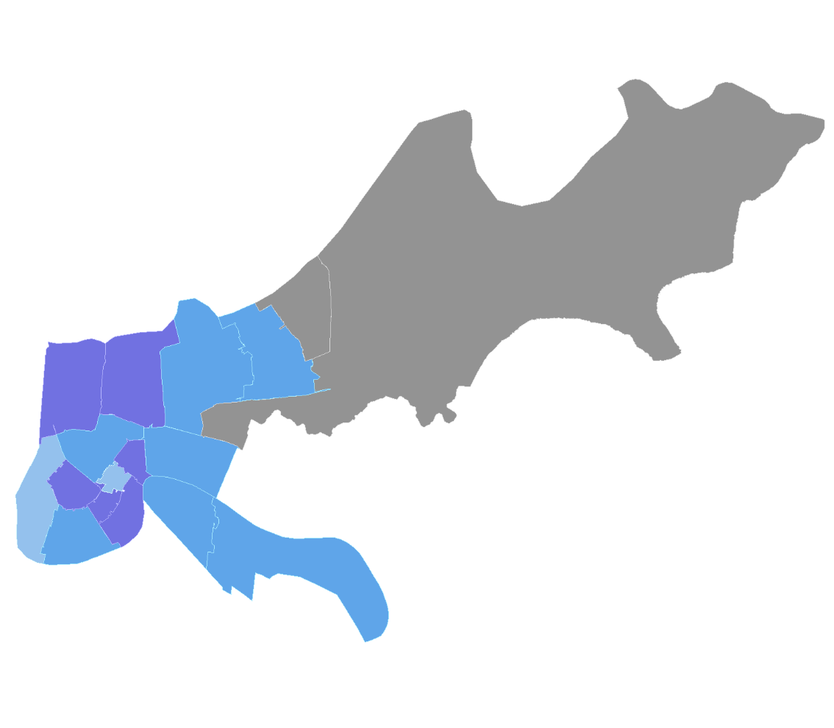
Proportion of Those Newly Diagnosed with HIV Late in the Course of HIV Infection, by ZIP Code, New Orleans,
2007-2011
Proportion of adults/adolescents newly diagnosed with HIV from 2007-2011 with an AIDS diagnosis within 3 months of HIV diagnosis
0-10 %
11-20 %
21-30 %
31-50 %
>50 %
Not Shown*
* Gray areas denote where data are not shown to protect privacy because of a small number of cases and/or a small population size.
Notes: Data reflect cases with a date of initial diagnosis 2007-2011 and reported through 10/30/2014. Data reflect cases from ZIP Codes in Orleans and Jefferson Parishes. Late HIV diagnosis was defined as immunologic or clinical AIDS (new CDC classification as A3, B3, or C1-C3) within 3 months of initial HIV diagnosis. New HIV diagnoses and late diagnoses indicators come from a mature HIV case surveillance system. Linkage to care, engagement in care, and viral suppression are new indicators and rapidly developing, and thus accuracy and completeness will improve over time. For more information on data limitations and caveats, please see Data Methods. Data Source: Louisiana Office of Public Health, STD/HIV Program.
Notes:
Proportion of those newly diagnosed with HIV late in the course of HIV infection, by ZIP Code, New Orleans, 2007-2011.
Late HIV diagnosis was defined as immunologic or clinical AIDS (new CDC classification as A3, B3, or C1-C3) within 3 months of initial HIV diagnosis.
Data reflect cases with a date of initial diagnosis 2007-2011 and reported through 10/30/2014. Data reflect cases from ZIP Codes in Orleans and Jefferson Parishes. Cases missing ZIP Code at diagnosis are excluded from the maps.
New HIV diagnoses and late diagnoses indicators come from a mature HIV case surveillance system. Linkage to care, engagement in care, and viral suppression are new indicators and rapidly developing, and thus accuracy and completeness will improve over time.
More information about data methods and sources can be found at HIVContinuum.org.

Slide 7
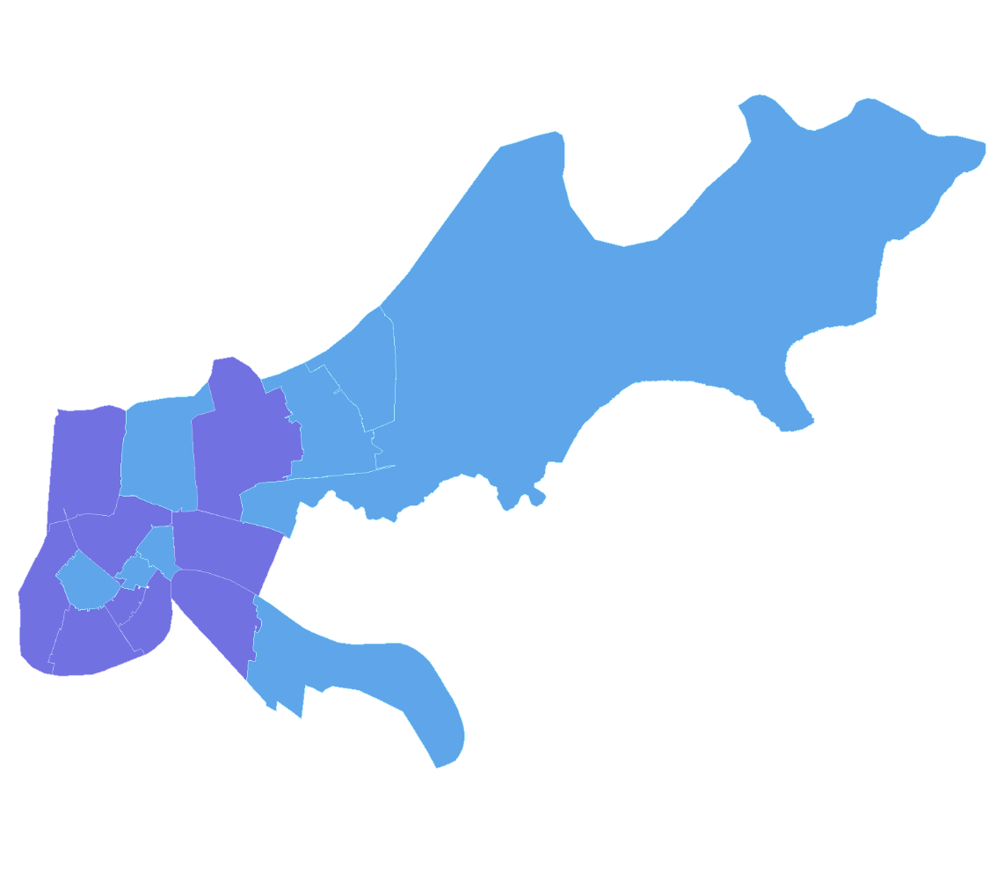
Proportion of Those Newly Diagnosed with HIV 2007-2011 Who were Linked to HIV Care,
by ZIP Code, New Orleans
Proportion of adults/adolescents newly diagnosed with HIV from 2007-2011 with a reported CD4/viral load within 3 months of HIV diagnosis
0-10 %
11-20 %
21-30 %
31-50 %
>50 %
Not Shown*
* Gray areas denote where data are not shown to protect privacy because of a small number of cases and/or a small population size.
Notes: Data reflect cases with a date of initial diagnosis 2007-2011 and reported through 10/30/2014. Data reflect cases from ZIP Codes in Orleans and Jefferson Parishes. Linkage to HIV care is defined as a report of a CD4 count or HIV viral load test within 3 months of initial HIV diagnosis. New HIV diagnoses and late diagnoses indicators come from a mature HIV case surveillance system. Linkage to care, engagement in care, and viral suppression are new indicators and rapidly developing, and thus accuracy and completeness will improve over time. For more information on data limitations and caveats, please see Data Methods.
Data Source: Louisiana Office of Public Health, STD/HIV Program.
Notes:
Proportion of Those Newly Diagnosed with HIV 2007-2011 Who were Linked to HIV Care, by ZIP Code, New Orleans
Linkage to HIV care is defined as a report of a CD4 count or HIV viral load test within 3 months of initial HIV diagnosis. Does not include tests done on the same date as the HIV diagnosis.
Data reflect cases with a date of initial diagnosis 2007-2011 and reported through 10/30/2014. Data reflect cases from ZIP Codes in Orleans and Jefferson Parishes. Cases missing ZIP Code at diagnosis are excluded from the maps.
New HIV diagnoses and late diagnoses indicators come from a mature HIV case surveillance system. Linkage to care, engagement in care, and viral suppression are new indicators and rapidly developing, and thus accuracy and completeness will improve over time. More information about data methods and sources can be found at HIVContinuum.org.

Slide 8
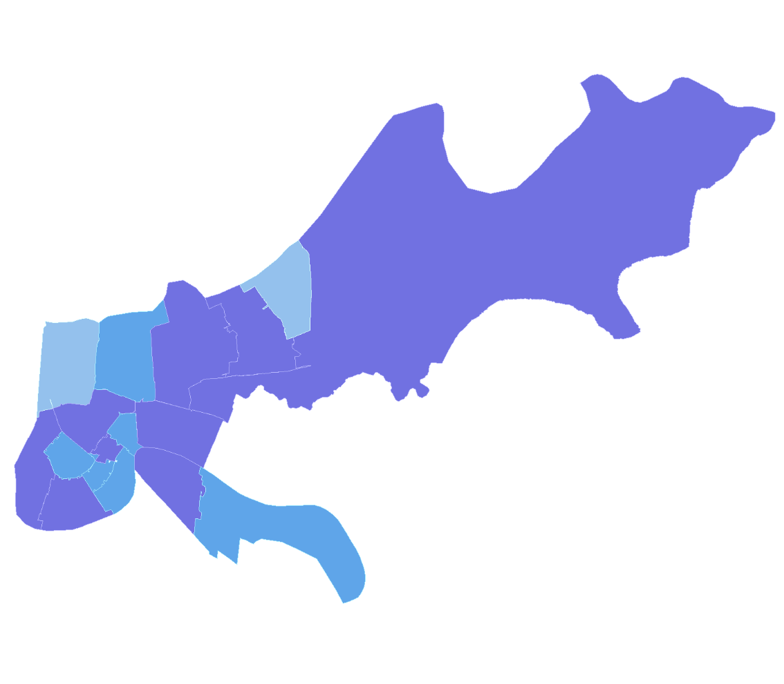
Proportion of Those Newly Diagnosed with HIV 2007-2011 Who were Engaged in HIV Care in 2012, by ZIP Code, New Orleans
Proportion of adults/adolescents newly diagnosed with HIV from 2007-2011 and engaged in HIV care with a reported CD4/viral load in 2012
0-10 %
11-20 %
21-30 %
31-50 %
>50 %
Not Shown*
* Gray areas denote where data are not shown to protect privacy because of a small number of cases and/or a small population size.
Notes: Data reflect cases with a date of initial diagnosis 2007-2011 and reported through 10/30/2014. Data reflect cases from ZIP Codes in Orleans and Jefferson Parishes. Engaged in HIV care is defined as a report of a CD4 count or HIV viral load test in 2012 among those who were initially linked to HIV care. New HIV diagnoses and late diagnoses indicators come from a mature HIV case surveillance system. Linkage to care, engagement in care, and viral suppression are new indicators and rapidly developing, and thus accuracy and completeness will improve over time. For more information on data limitations and caveats, please see Data Methods.
Data Source: Louisiana Office of Public Health, STD/HIV Program.
Notes:
Proportion of Those Newly Diagnosed with HIV 2007-2011 Who were Engaged in HIV Care in 2012, by ZIP Code, New Orleans
Engaged in HIV care is defined as a report of a CD4 count or HIV viral load test in 2012 among those who at least one previous CD4 count of HIV viral load test (i.e., those who were linked to HIV care).
Data reflect cases with a date of initial diagnosis 2007-2011 and reported through 10/30/2014. Data reflect cases from ZIP Codes in Orleans and Jefferson Parishes. Cases missing ZIP Code at diagnosis are excluded from the maps.
New HIV diagnoses and late diagnoses indicators come from a mature HIV case surveillance system. Linkage to care, engagement in care, and viral suppression are new indicators and rapidly developing, and thus accuracy and completeness will improve over time.
More information about data methods and sources can be found at HIVContinuum.org.

Slide 9
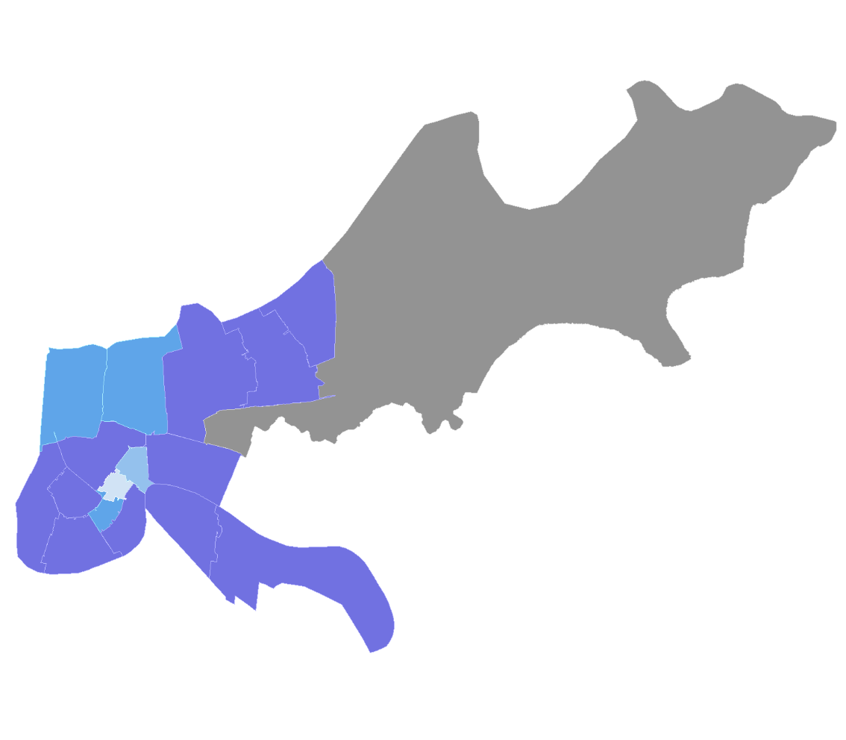
HIV Viral Load Suppression in 2012 Among Those Newly Diagnosed 2007-2011 and Who were Engaged in Care, by ZIP Code, New Orleans
Proportion of adults/adolescents newly diagnosed with HIV from 2007-2011 and engaged in HIV care in 2012 with a suppressed HIV viral load in 2012
0-10 %
11-20 %
21-30 %
31-50 %
>50 %
Not Shown*
* Gray areas denote where data are not shown to protect privacy because of a small number of cases and/or a small population size.
Notes: Data reflect cases with a date of initial diagnosis 2007-2011 and reported through 10/30/2014. Data reflect cases from ZIP Codes in Orleans and Jefferson Parishes. Engaged in care for this indicator is defined as a report of an HIV viral load test. HIV viral load suppression is defined as the most recent viral load < 200 copies/ml. New HIV diagnoses and late diagnoses indicators come from a mature HIV case surveillance system. Linkage to care, engagement in care, and viral suppression are new indicators and rapidly developing, and thus accuracy and completeness will improve over time. For more information on data limitations and caveats, please see Data Methods.
Data Source: Louisiana Office of Public Health, STD/HIV Program.
Notes:
HIV Viral Load Suppression Among Those Newly Diagnosed 2007-2011 and Who were Engaged in Care in 2012, by ZIP Code, New Orleans
Engaged in care for this indicator is defined as a report of an HIV viral load test.
HIV viral load suppression is defined as the most recent viral load < 200 copies/ml.
Data reflect cases with a date of initial diagnosis 2007-2011 and reported through 10/30/2014. Data reflect cases from ZIP Codes in Orleans and Jefferson Parishes. Cases missing ZIP Code at diagnosis are excluded from the maps.
New HIV diagnoses and late diagnoses indicators come from a mature HIV case surveillance system. Linkage to care, engagement in care, and viral suppression are new indicators and rapidly developing, and thus accuracy and completeness will improve over time. More information about data methods and sources can be found at HIVContinuum.org.

Slide 10
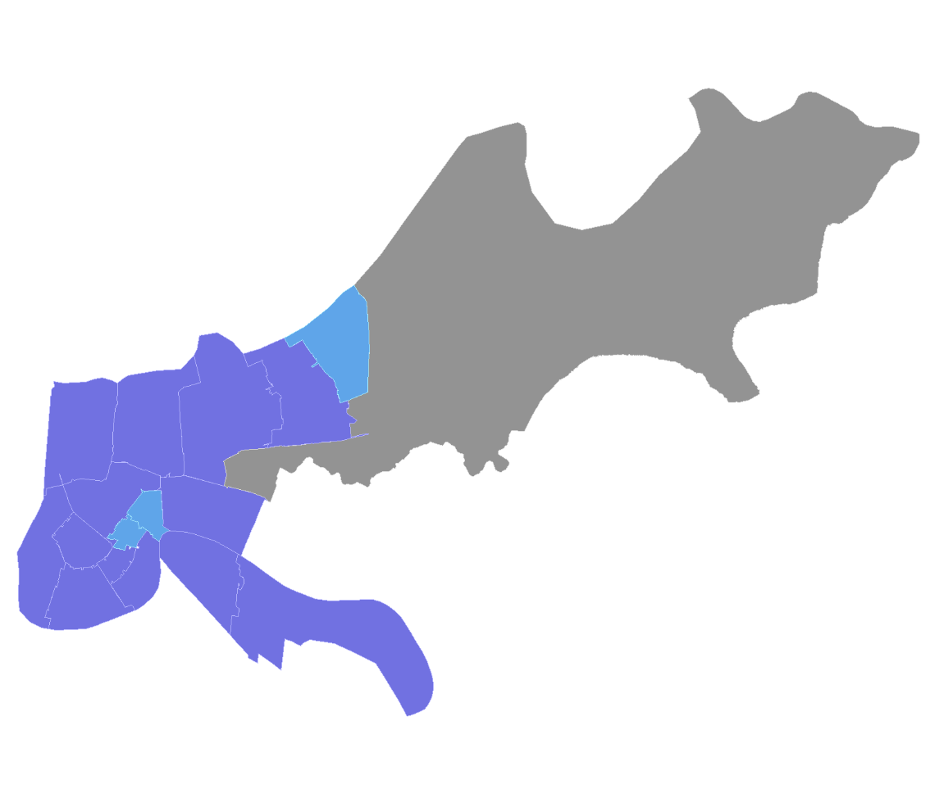
HIV Viral Load Suppression in 2012 Among Those Newly Diagnosed 2007-2011, by ZIP Code, New Orleans
Proportion of adults/adolescents newly diagnosed with HIV from 2007-2011 with a suppressed HIV viral load in 2012
0-10 %
11-20 %
21-30 %
31-50 %
>50 %
Not Shown*
* Gray areas denote where data are not shown to protect privacy because of a small number of cases and/or a small population size.
Notes: Data reflect cases with a date of initial diagnosis 2007-2011 and reported through 10/30/2014. Data reflect cases from ZIP Codes in Orleans and Jefferson Parishes. HIV viral load suppression is defined as the most recent viral load < 200 copies/ml. New HIV diagnoses and late diagnoses indicators come from a mature HIV case surveillance system. Linkage to care, engagement in care, and viral suppression are new indicators and rapidly developing, and thus accuracy and completeness will improve over time. For more information on data limitations and caveats, please see Data Methods.
Data Source: Louisiana Office of Public Health, STD/HIV Program.
Notes:
HIV Viral Load Suppression in 2012 Among Those Newly Diagnosed 2007-2011, by ZIP Code, New Orleans
HIV viral load suppression is defined as the most recent viral load < 200 copies/ml.
Data reflect cases with a date of initial diagnosis 2007-2011 and reported through 10/30/2014. Data reflect cases from ZIP Codes in Orleans and Jefferson Parishes. Cases missing ZIP Code at diagnosis are excluded from the maps.
New HIV diagnoses and late diagnoses indicators come from a mature HIV case surveillance system. Linkage to care, engagement in care, and viral suppression are new indicators and rapidly developing, and thus accuracy and completeness will improve over time. More information about data methods and sources can be found at HIVContinuum.org.

Slide 11
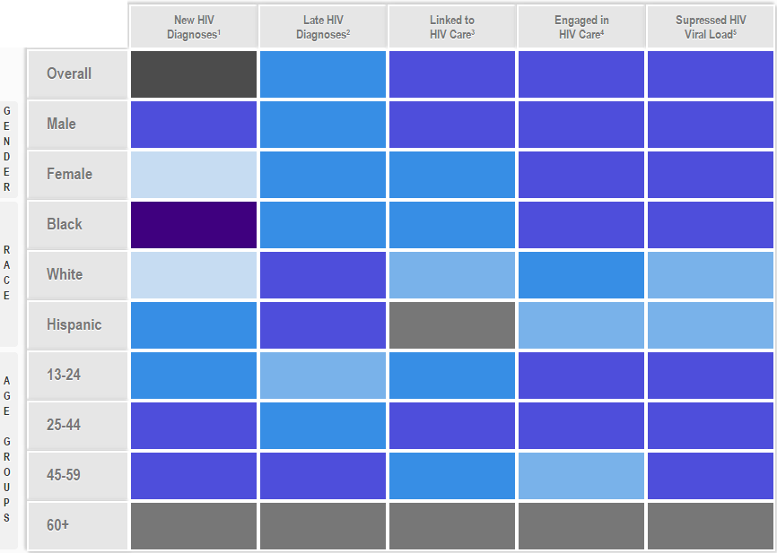
The HIV Care Continuum Among Those Newly Diagnosed with HIV, by Demographic Groups, New Orleans, 2007-2011
Note: The color within each box corresponds to the most frequent category of the outcome at the ZIP Code level for each sub-group. The categories for new HIV diagnoses were created from the overall data, therefore no mode exists (gray box).
1 New HIV diagnoses 2007-2011 per 100,000 persons
2 Proportion with AIDS within 3 months of diagnosis
3 Proportion with a CD4 or viral load within 3 months of diagnosis
4 Proportion with a CD4 or viral load in 2012
5 Proportion with suppressed HIV viral load in 2012
Data Source: Louisiana Office of Public Health, STD/HIV Program.
Notes:
The HIV Care Continuum Among Those Newly Diagnosed with HIV, by Demographic Groups, New Orleans, 2007-2011
The color within each box corresponds to the most frequent category of the outcome at the ZIP Code level for each sub-group. The categories for new HIV diagnoses were created from the overall data, therefore no mode exists (gray box).
1 New HIV diagnoses 2007-2011 per 100,000 persons
2 Proportion with AIDS within 3 months of diagnosis
3 Proportion with a CD4 or viral load within 3 months of diagnosis
4 Proportion with a CD4 or viral load in 2012
5 Proportion with suppressed HIV viral load in 2012
Data reflect cases with a date of initial diagnosis 2007-2011 and reported through 10/30/2014. Data reflect cases from ZIP Codes in Orleans and Jefferson Parishes. Cases missing ZIP Code at diagnosis are excluded from the maps. More information about data methods and sources can be found at HIVContinuum.org.

Slide 12
Map Details
Data on HIVContinuum may differ from data released in local HIV surveillance reports.
The HIVContinuum maps do not reflect undiagnosed cases.
As is standard in the display of health statistics, data generated from a numerator less than 12 are considered unstable and should be interpreted with caution – this situation occurs frequently with HIV care continuum mapping at this level of detail.
The case definitions and data systems for new HIV diagnoses and late HIV diagnoses are standard in HIV case surveillance, but standardization for the other indicators used here is still a work-in-progress.
Notes:
HIV care continuum data on HIVContinuum may differ slightly from data released by local HIV surveillance programs because of different analysis criteria and indicator definitions.
HIVContinuum maps do not reflect undiagnosed cases.
As is standard in the display of health statistics, data generated from a numerator less than 12 are considered unstable and should be interpreted with caution – this situation occurs frequently with HIV care continuum mapping at this level of detail.
The case definitions and data systems for new HIV diagnoses and late HIV diagnoses are standard in HIV case surveillance, but standardization for the other indicators used here is still a work-in-progress.

Slide 13
Contact Information
More map views are available at HIVContinuum.org
For more information about HIVContinuum,
including information about custom map views and
images, please email info@hivcontinuum.org
Connect With Us
HIV CareContinuum
@HIVContinuum
HIV Care Continuum

