Slide 1
Illustrating the HIV Care Continuum in U.S. Cities
Texas

Slide 2
About
Effective treatment requires successful HIV diagnosis as well as linkage and retention in HIV care - this is the HIV care continuum.
To be the most impactful, public health strategies that address gaps in the HIV care continuum will require detailed information on disproportionately impacted populations.
HIVContinuum.org is a compilation of interactive, online maps that allows users to connect with complex information about the HIV care continuum in several highly impacted cities in the U.S.
HIVContinuum.org is powered by AIDSVu and uses public health surveillance data to increase understanding of the HIV treatment cascade by visualizing the impact of HIV on specific demographic groups, neighborhoods and Countys.

Slide 3
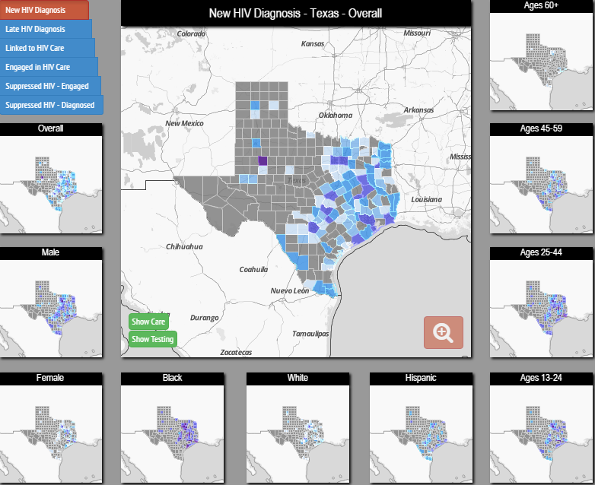
Interactive Maps
Maps at the County Level
New HIV Diagnoses
Late HIV Diagnoses
Linkage to
HIV Care
Engagement in HIV Care
HIV Viral Suppression
Notes:
HIVContinuum uses data from trusted sources to populate its interactive maps.
County and County data come directly from jurisdictions’ health departments.
The following indicators of the HIV care continuum are mapped overall and by gender, race/ethnicity, and age group:
New HIV Diagnoses
Late HIV Diagnoses
Linkage to HIV Care
Engagement in HIV Care
HIV Viral Suppression (of those engaged in care and of people living with HIV)

Slide 4
Supporting the National HIV/AIDS Strategy
Prevent new HIV infections
Improve care and treatment
Reduce HIV-related health disparities
HIVContinuum provides a new way to identify places where we can improve HIV testing, care and treatment.
Notes:
HIVContinuum can play a direct role in supporting the National HIV/AIDS Strategy goals. The President of the United States called for acceleration of our progress on the National Strategy through an initiative focused on the HIV care continuum.
HIVContinuum images can increase a community’s awareness of the problem and lead directly to more action to prevent new HIV infections and improve HIV diagnosis, care, and treatment.
HIVContinuum can also be a resource to identify areas and populations most highly affected by HIV, and where HIV prevention, care, and treatment resources may be most needed and most impactful.

Slide 5
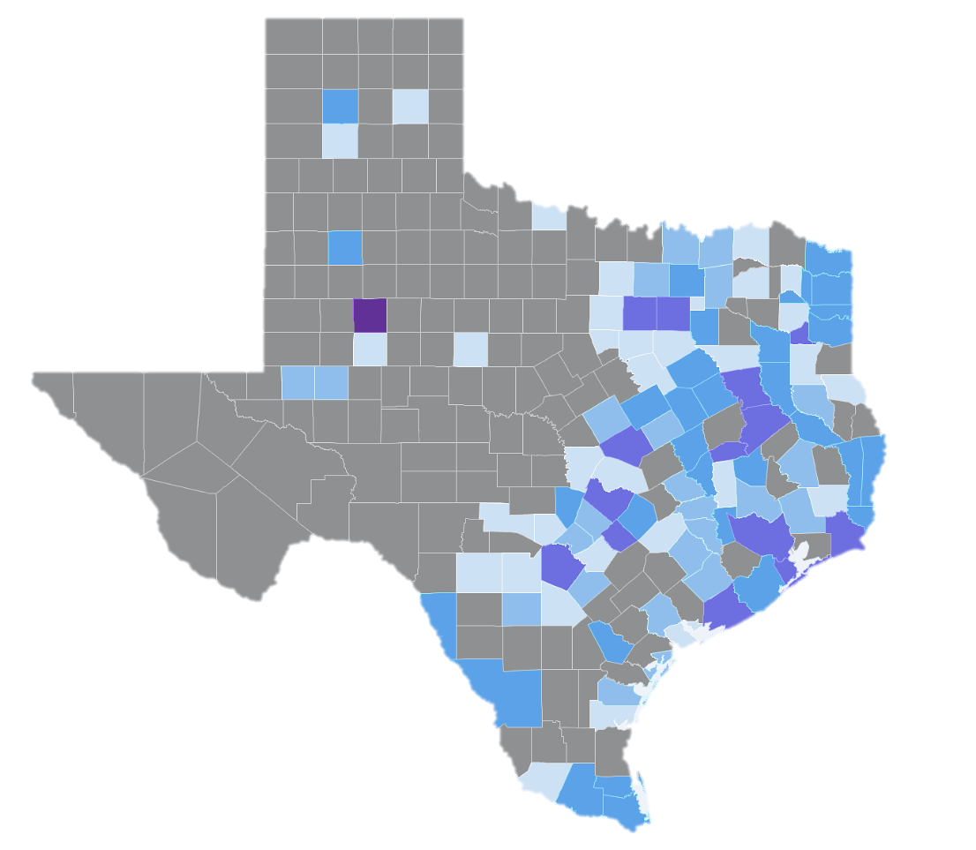
Five-Year Risk of New HIV Diagnosis,
by County, Texas, 2010-2014
Five-year risk of new HIV diagnosis, 2010-2014 (per 100,000 population of adults/adolescents in 2010)
0-27
28-36
37-49
50-60
61+
Not Shown*
* Gray areas denote where data are not shown to protect privacy because of a small number of cases and/or a small population size.
Notes: Data represent the 5-year (2010-2014) risk of new HIV diagnosis among the adult/adolescent population within each county/County. New HIV diagnoses and late diagnoses indicators come from a mature HIV case surveillance system. Linkage to care, engagement in care, and viral suppression are new indicators and rapidly developing, and thus accuracy and completeness will improve over time. For more information on data limitations and caveats, please see Data Methods.
Data Source: Texas Department of State Health Services, HIV/STD Prevention and Care Branch
Notes:
Five-year risk of new HIV diagnosis, by County, Texas, 2010-2014 This map shows the reported County-level risk of new HIV diagnosis during a 5-year period (2010-2014) per 100,000 population in 2010.
Data represent the 5-year (2010-2014) risk of new HIV diagnosis among the adult/adolescent population within each County. This indicator is not a rate of new diagnosis. The numerator is the number of new HIV diagnoses between 2010-2014, inclusive, among those aged 13 years and older at diagnosis. The denominator for this proportion is the 2010 census population aged 13 years and older obtained from the U.S. Census Bureau.
New HIV diagnoses and late diagnoses indicators come from a mature HIV case surveillance system. Linkage to care, engagement in care, and viral suppression are new indicators and rapidly developing, and thus accuracy and completeness will improve over time.
More information about data methods and sources can be found at HIVContinuum.org.

Slide 6
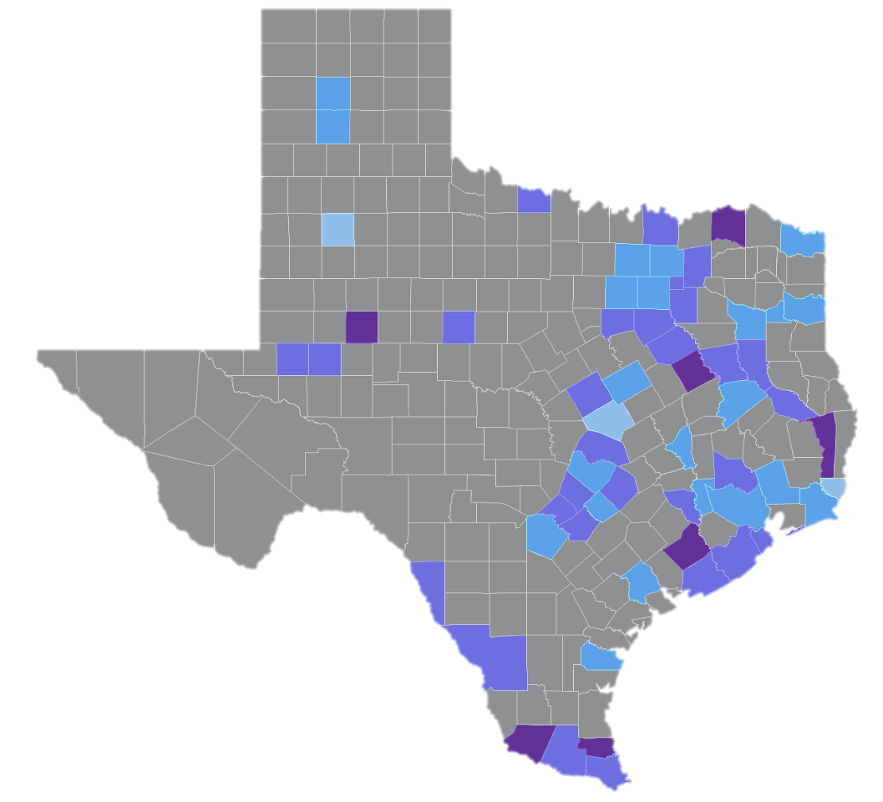
Proportion of those Newly Diagnosed with HIV Late in the Course of HIV Infection, by County,
Texas, 2010-2014
Proportion of adults/adolescents newly diagnosed with HIV from 2010-2014 with an AIDS diagnosis within 3 months of HIV diagnosis
0-10 %
11-20 %
21-30 %
31-50 %
>50 %
Not Shown*
* Gray areas denote where data are not shown to protect privacy because of a small number of cases and/or a small population size.
Notes: The data represents the proportion of adults/adolescents diagnosed with HIV between 2010-2014 within each county/County who were diagnosed late in the HIV disease process. Late HIV diagnosis was defined as immunologic or clinical AIDS (new CDC classification as A3, B3, or C1-C3) within 3 months of initial HIV diagnosis. New HIV diagnoses and late diagnoses indicators come from a mature HIV case surveillance system. Linkage to care, engagement in care, and viral suppression are new indicators and rapidly developing, and thus accuracy and completeness will improve over time. For more information on data limitations and caveats, please see Data Methods.
Data Source: Texas Department of State Health Services, HIV/STD Prevention and Care Branch
Notes:
This map represents the proportion of adults/adolescents diagnosed with HIV between 2010-2014 within each County who were diagnosed late in the HIV disease process.
Late HIV diagnosis was defined as immunologic or clinical AIDS (new CDC classification as A3, B3, or C1-C3) within 3 months of initial HIV diagnosis.
New HIV diagnoses and late diagnoses indicators come from a mature HIV case surveillance system. Linkage to care, engagement in care, and viral suppression are new indicators and rapidly developing, and thus accuracy and completeness will improve over time.
More information about data methods and sources can be found at HIVContinuum.org.

Slide 7
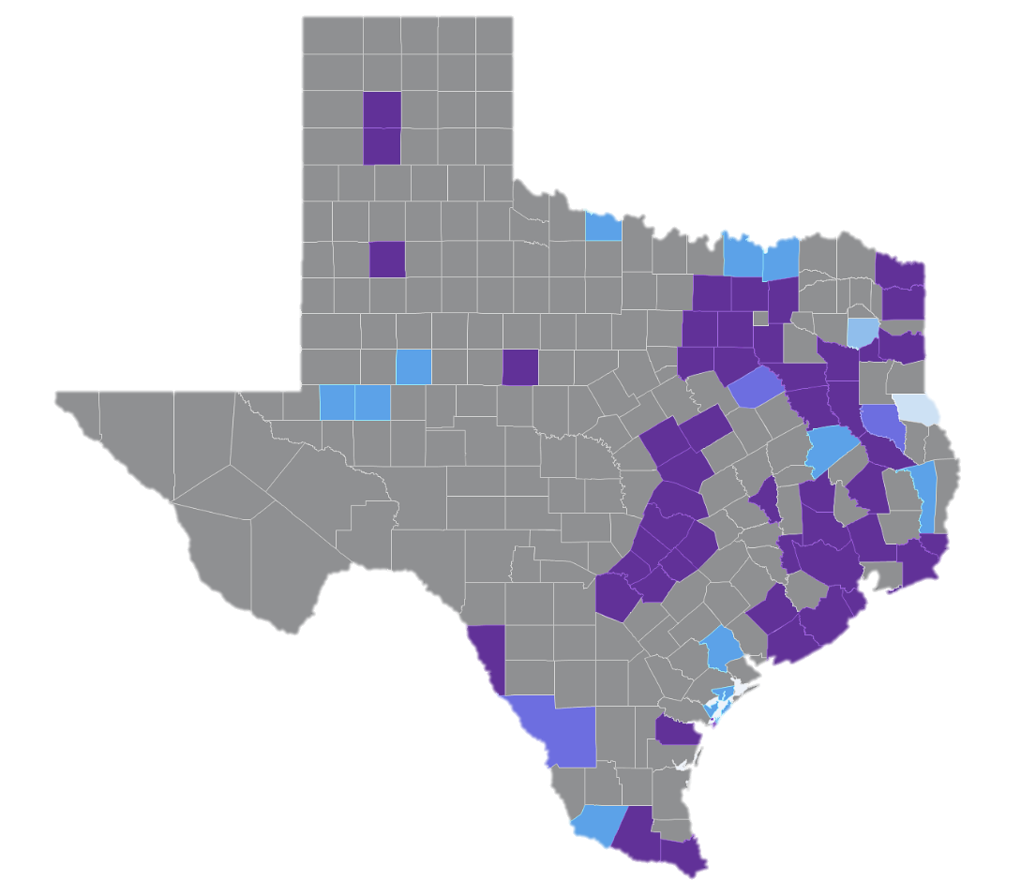
Proportion of those Newly Diagnosed with HIV
2010-2014 who were Linked to HIV Care,
by County, Texas
Proportion of adults/adolescents newly diagnosed with HIV from 2010-2014 with a reported CD4/viral load within 3 months of HIV diagnosis
85-100 %
75-84 %
60-74 %
50-59 %
<50 %
Not Shown*
* Gray areas denote where data are not shown to protect privacy because of a small number of cases and/or a small population size.
Notes: Data represents the proportion of adults/adolescents diagnosed with HIV between 2010-2014 within each county/County who were linked to HIV care within 1 month of their diagnosis. New HIV diagnoses and late diagnoses indicators come from a mature HIV case surveillance system. Linkage to care, engagement in care, and viral suppression are new indicators and rapidly developing, and thus accuracy and completeness will improve over time. For more information on data limitations and caveats, please see Data Methods.
Data Source: Texas Department of State Health Services, HIV/STD Prevention and Care Branch
Notes:
This map represents the proportion of adults/adolescents diagnosed with HIV between 2010-2014 within each County who were linked to HIV care within 1 month of their diagnosis.
Data does not include tests done on the same date as the HIV diagnosis.
New HIV diagnoses and late diagnoses indicators come from a mature HIV case surveillance system. Linkage to care, engagement in care, and viral suppression are new indicators and rapidly developing, and thus accuracy and completeness will improve over time.
More information about data methods and sources can be found at HIVContinuum.org.

Slide 8
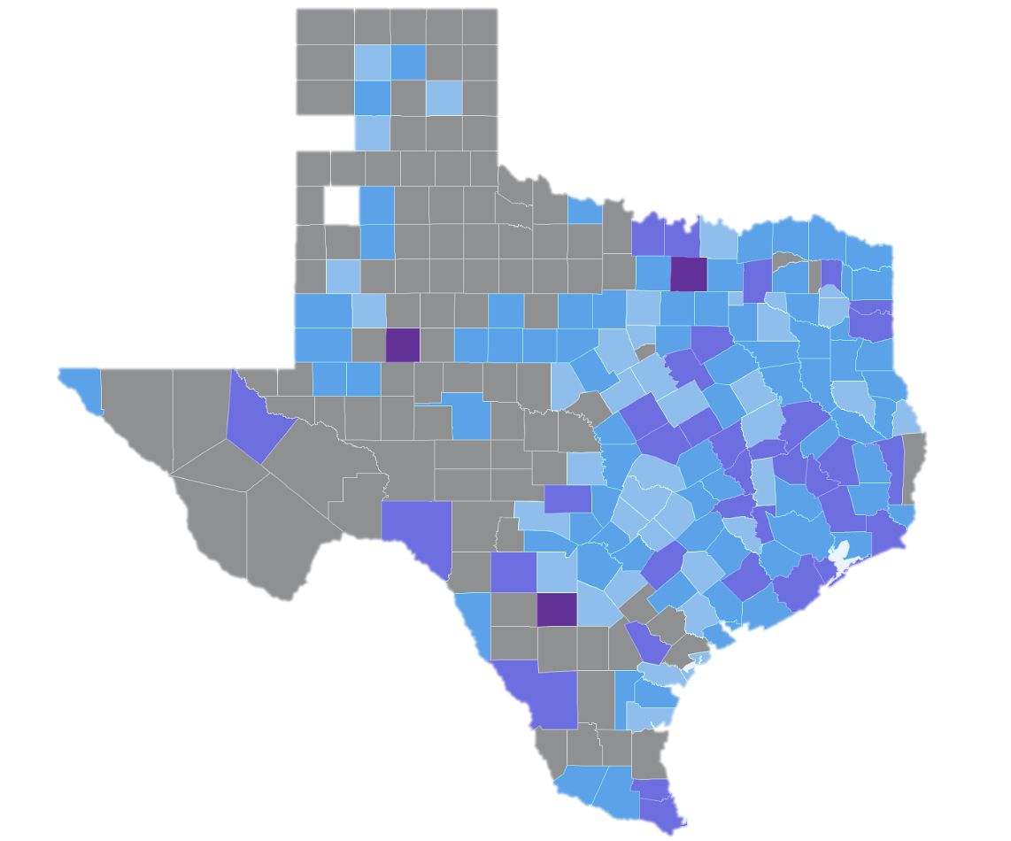
Engagement in Care among those Living with Diagnosed HIV Infection in 2015, Excluding Those Newly Diagnosed in 2015, by County, Texas
Proportion of adults/adolescents living with diagnosed HIV infection in 2015, excluding those diagnosed in 2015, who had a suppressed HIV VL in 2015
90-100 %
80-89 %
70-79 %
50-69 %
<50 %
Not Shown*
* Gray areas denote where data are not shown to protect privacy because of a small number of cases and/or a small population size.
Notes: Data represent the proportion of adults/adolescents living with diagnosed HIV infection in 2015, excluding those newly diagnosed in 2015, who were engaged in care in 2015. Engaged in care for this indicator is defined as having a most recent CD4 count or HIV viral load test in 2015. New HIV diagnoses and late diagnoses indicators come from a mature HIV case surveillance system. Linkage to care, engagement in care, and viral suppression are new indicators and rapidly developing, and thus accuracy and completeness will improve over time. For more information on data limitations and caveats, please see Data Methods.
Data Source: Texas Department of State Health Services, HIV/STD Prevention and Care Branch
Notes:
This map represents the proportion of adults/adolescents living with diagnosed HIV infection in 2015, excluding those newly diagnosed in 2015, who were engaged in care in 2015.
Engaged in care for this indicator is defined as having a most recent CD4 count or HIV viral load test in 2015.
New HIV diagnoses and late diagnoses indicators come from a mature HIV case surveillance system. Linkage to care, engagement in care, and viral suppression are new indicators and rapidly developing, and thus accuracy and completeness will improve over time.
More information about data methods and sources can be found at HIVContinuum.org.

Slide 9
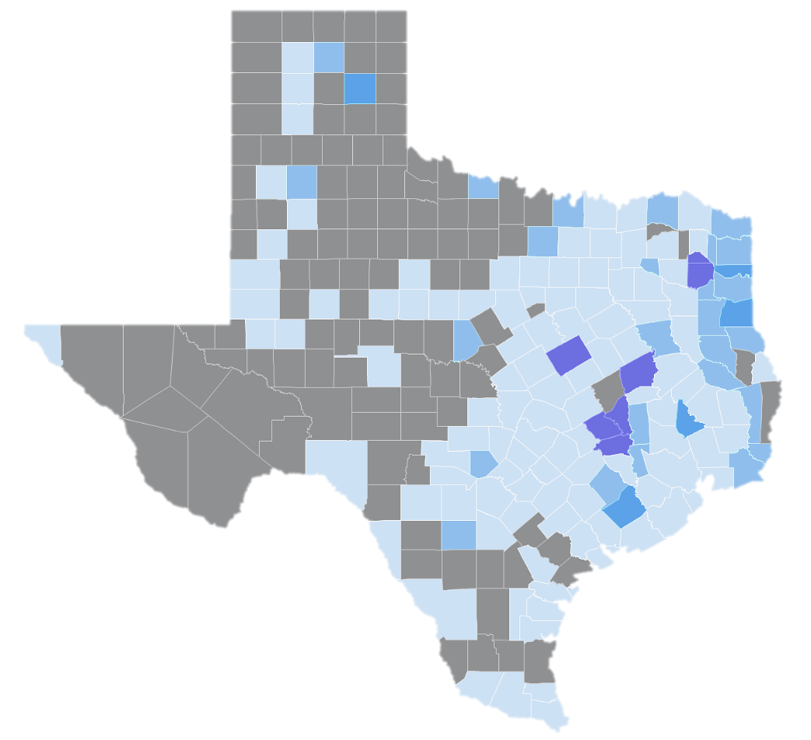
HIV Viral Load Suppression among those Engaged
in Care, who were Living with Diagnosed HIV Infection
in 2015, Excluding those Newly Diagnosed in 2015,
by County, Texas
Proportion of adults/adolescents living with diagnosed HIV infection in 2015, excluding those newly diagnosed in 2015, who had a suppressed HIV VL in 2015 and engaged in care.
80-100 %
70-79 %
60-69 %
50-59 %
<50 %
Not Shown*
* Gray areas denote where data are not shown to protect privacy because of a small number of cases and/or a small population size.
Notes: Data represents the proportion of adults/adolescents living with diagnosed HIV infection in 2015, excluding those newly diagnosed in 2015, who had a suppressed HIV VL in 2015 and engaged in care. Engaged in care for this indicator is defined as having a most recent CD4 count or HIV viral load test in 2015. HIV viral load suppression is defined as the most recent viral load < 200 copies/ml. New HIV diagnoses and late diagnoses indicators come from a mature HIV case surveillance system. Linkage to care, engagement in care, and viral suppression are new indicators and rapidly developing, and thus accuracy and completeness will improve over time. For more information on data limitations and caveats, please see Data Methods.
Data Source: Texas Department of State Health Services, HIV/STD Prevention and Care Branch
Notes:
HIV Viral Load Suppression Among Those Engaged in Care: This value represents the proportion of adults/adolescents living with diagnosed HIV infection in 2015, excluding those newly diagnosed in 2015, who had a suppressed HIV VL in 2015 and engaged in care.
Engaged in care for this indicator is defined as having a most recent CD4 count or HIV viral load test in 2015.
HIV viral load suppression is defined as the most recent viral load < 200 copies/ml.
New HIV diagnoses and late diagnoses indicators come from a mature HIV case surveillance system. Linkage to care, engagement in care, and viral suppression are new indicators and rapidly developing, and thus accuracy and completeness will improve over time.
More information about data methods and sources can be found at HIVContinuum.org.

Slide 10
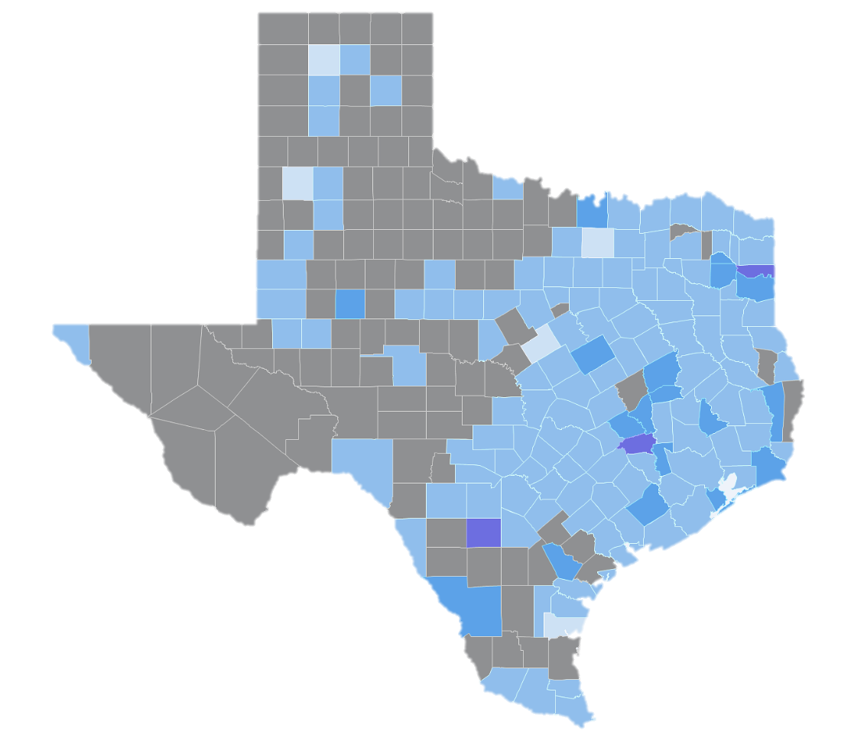
HIV Viral Load Suppression Among Those Living with Diagnosed HIV Infection in 2015, Excluding Those Diagnosed in 2015, by County, Texas
Proportion of adults/adolescents living with diagnosed HIV infection in 2015, excluding those diagnosed in 2015, who had a suppressed HIV VL in 2015
80-100 %
50-79 %
40-49 %
30-39 %
<30 %
Not Shown*
* Gray areas denote where data are not shown to protect privacy because of a small number of cases and/or a small population size.
Notes: Data represent the proportion of adults/adolescents living with diagnosed HIV infection in 2015, excluding those newly diagnosed in 2015, who had a suppressed HIV VL in 2015. HIV viral load suppression is defined as the most recent viral load < 200 copies/ml. New HIV diagnoses and late diagnoses indicators come from a mature HIV case surveillance system. Linkage to care, engagement in care, and viral suppression are new indicators and rapidly developing, and thus accuracy and completeness will improve over time. For more information on data limitations and caveats, please see Data Methods.
Data Source: Texas Department of State Health Services, HIV/STD Prevention and Care Branch
Notes:
This map represents the proportion of adults/adolescents living with diagnosed HIV infection in 2015, excluding those newly diagnosed in 2015, who had a suppressed HIV VL in 2015.
HIV viral load suppression is defined as the most recent viral load < 200 copies/ml.
New HIV diagnoses and late diagnoses indicators come from a mature HIV case surveillance system. Linkage to care, engagement in care, and viral suppression are new indicators and rapidly developing, and thus accuracy and completeness will improve over time.
More information about data methods and sources can be found at HIVContinuum.org.

Slide 11
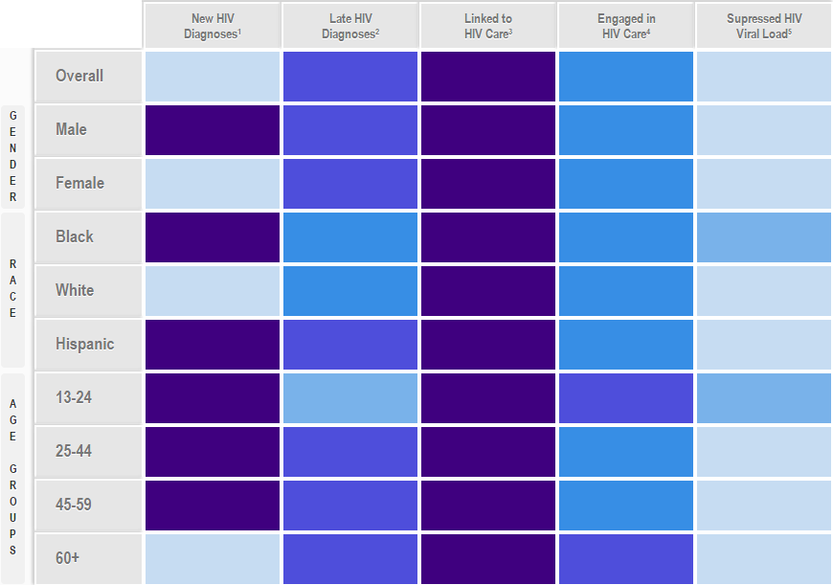
The HIV Care Continuum Among Those Newly Diagnosed with HIV, by Demographic Groups, Texas, 2010-2014
Note: The color within each box corresponds to the most frequent category of the outcome at the Ward level for each sub-group. The categories for new HIV diagnoses were created from the overall data, therefore no mode exists (gray box).
1 New HIV diagnoses 2010-2014 per 100,000 persons
2 Proportion with AIDS within 3 months of diagnosis
3 Proportion with a CD4 or viral load within 1 months of diagnosis
4 Proportion with a CD4 or viral load in 2015
5 Proportion with suppressed HIV viral load in 2015
Data Source: Texas Department of State Health Services, HIV/STD Prevention and Care Branch
Notes:
The HIV Care Continuum Among Those Newly Diagnosed with HIV, by Demographic Groups, Texas, 2010-2014
The color within each box corresponds to the most frequent category of the outcome at the Ward level for each sub-group. The categories for new HIV diagnoses were created from the overall data, therefore no mode exists (gray box).
1 New HIV diagnoses 2010-2014 per 100,000 persons
2 Proportion with AIDS within 3 months of diagnosis
3 Proportion with a CD4 or viral load within 1 months of diagnosis
4 Proportion with a CD4 or viral load in 2015
5 Proportion with suppressed HIV viral load in 2015
More information about data methods and sources can be found at HIVContinuum.org.

Slide 12
Map Details
Data on HIVContinuum may differ from data released in local HIV surveillance reports.
The HIVContinuum maps do not reflect undiagnosed cases.
The case definitions and data systems for new HIV diagnoses and late HIV diagnoses are standard in HIV case surveillance, but standardization for the other indicators used here is still a work-in-progress.
More information about data methods and sources can be found at HIVContinuum.org.
Notes:
HIV care continuum data on HIVContinuum may differ slightly from data released by local HIV surveillance programs because of different analysis criteria and indicator definitions.
HIVContinuum maps do not reflect undiagnosed cases.
As is standard in the display of health statistics, data generated from a numerator less than 12 are considered unstable and should be interpreted with caution – this situation occurs frequently with HIV care continuum mapping at this level of detail.
The case definitions and data systems for new HIV diagnoses and late HIV diagnoses are standard in HIV case surveillance, but standardization for the other indicators used here is still a work-in-progress.
More information about data methods and sources can be found at HIVContinuum.org.

Slide 13
Contact Information
More map views are available at HIVContinuum.org
For more information about HIVContinuum,
including information about custom map views and
images, please email info@hivcontinuum.org
Connect With Us
HIV CareContinuum
@HIVContinuum
HIV Care Continuum

